Slide 1
DIGITAL MARKETING COURSE
Module 5: Blogging
Learn by doing: set up, write, promote and monetise a blog using free tools
Prepared by Soham Kore
Disha Computer Institute, Dehugaon

Slide 2
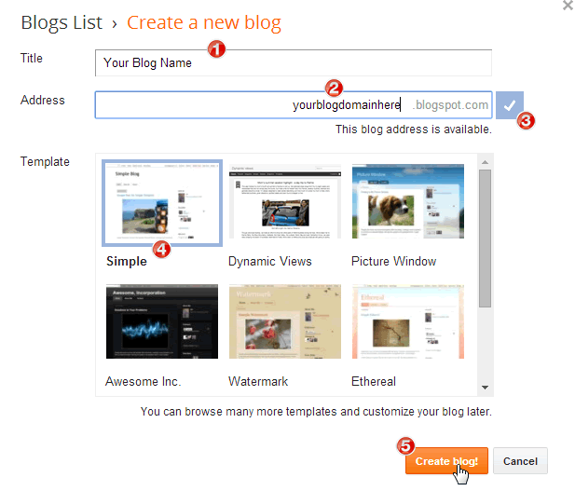
1
Introduction to Blogging
DO IT LIVE
Pick a niche you can write 20 posts on (food, tech, travel, local business)
Compare blog platforms: Blogger vs WordPress.com vs Medium
Create a free Blogger blog in under 5 minutes
Publish a "Hello World" post and open it on your phone
FREE TOOLS
Blogger
WordPress.com
Medium
Google Trends

Slide 3
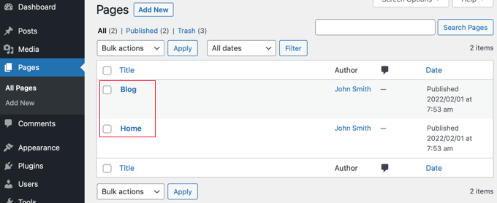
2
WordPress Blogging
DO IT LIVE
Sign up at WordPress.com and choose a free theme
Dashboard → Posts → Add New: write title and body in the block editor
Add H2 headings, an image, a category and tags
Set a featured image, then Publish and view the live post
Create About and Contact pages, set up the menu
FREE TOOLS
WordPress.com
LocalWP
Canva
Unsplash

Slide 4
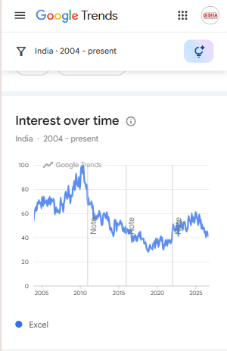
3
Tips for Successful Blog
DO IT LIVE
Research topics: compare 3 keywords in Google Trends
Write a headline, then test it in a headline analyzer
Paste your draft in Hemingway Editor, aim for Grade 8 or lower
Design a featured image in Canva (1200x630 px)
Plan 4 weeks of posts in a Google Sheets content calendar
FREE TOOLS
Google Trends
Hemingway
Canva
Google Sheets

Slide 5
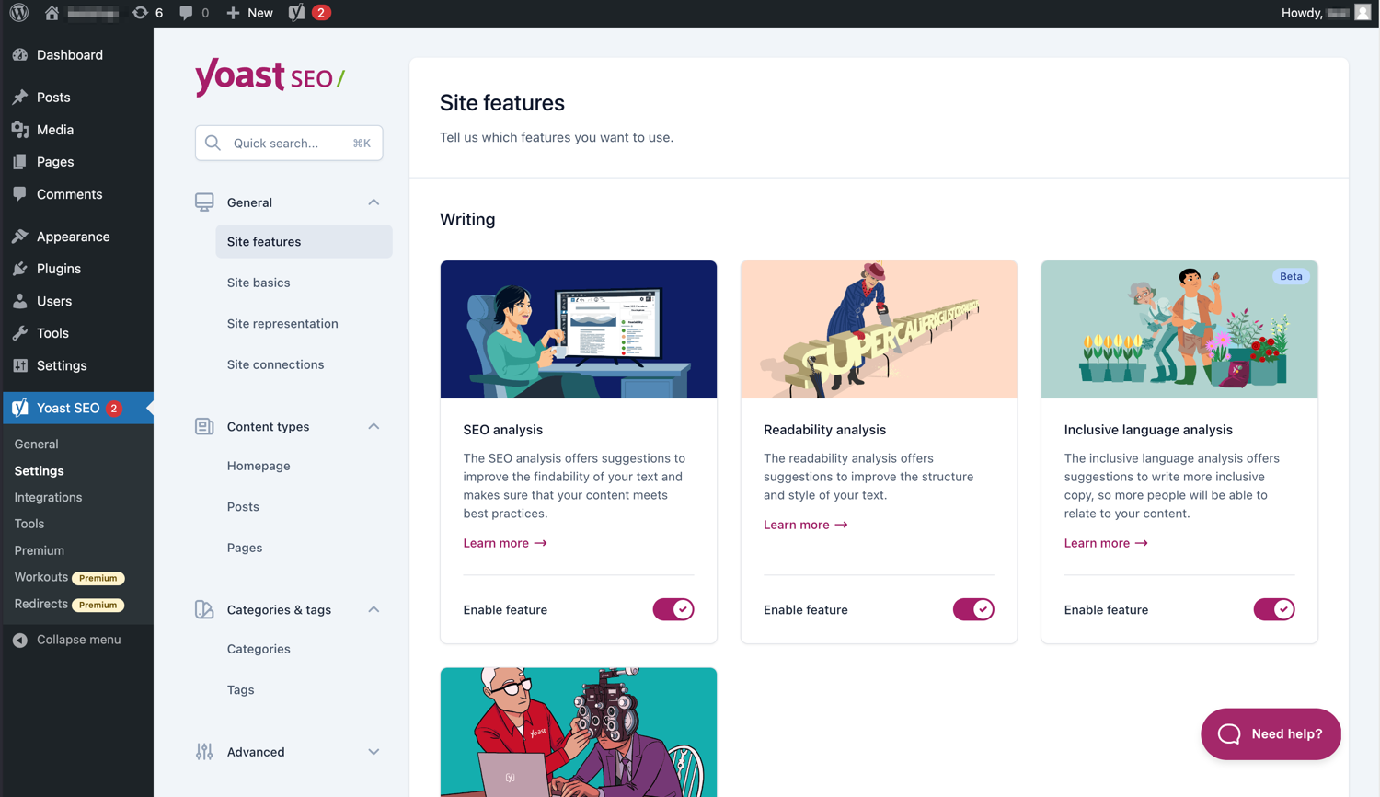
4
Blog Marketing
DO IT LIVE
Share the post on WhatsApp, LinkedIn and Facebook with a Canva graphic
Install Yoast SEO and fix the red/orange checks
Add an email signup form with Mailchimp or MailerLite
Verify the blog in Google Search Console to get indexed
Connect Google Analytics 4 and read the Traffic report
FREE TOOLS
Yoast SEO
Mailchimp
Search Console
Analytics 4

Slide 6
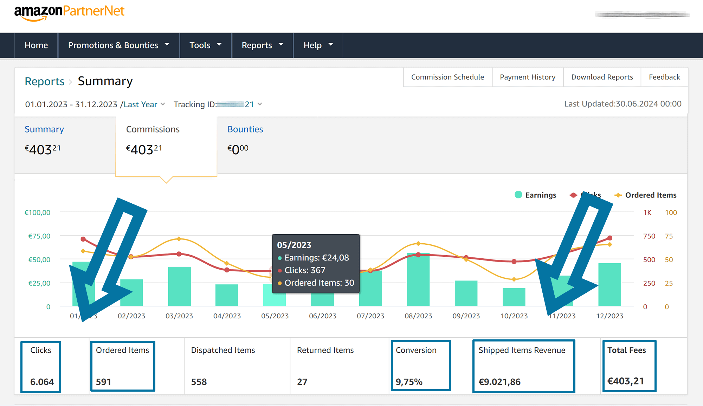
5
How to Make Money From Blog
DO IT LIVE
Join Amazon Associates or an Indian affiliate network and generate a product link
Insert the link in a "Top 5 tools" review post
Apply for Google AdSense once you have 15-20 quality posts
Create a free digital product (checklist PDF) on Gumroad
List services: freelance writing, SEO, social media
FREE TOOLS
AdSense
Amazon Associates
Gumroad
Canva

